Slide 1
Exact Learning Partition Functions
Molecular Simulation
Benedict Irwin

Slide 2
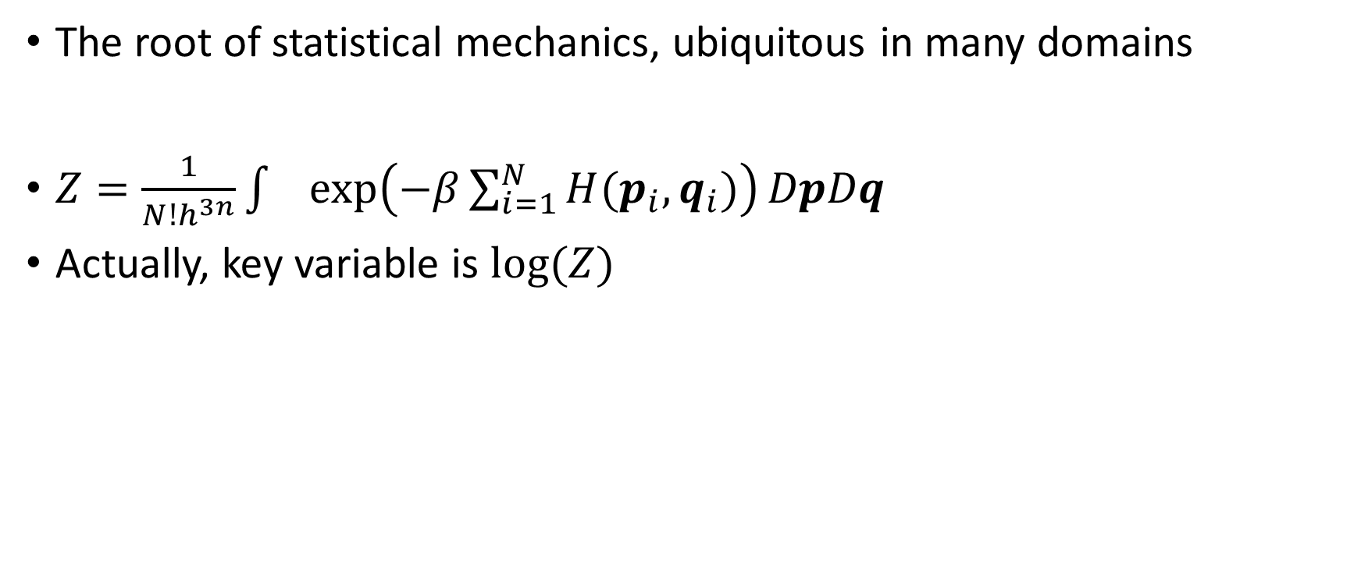
Partition Function
The root of statistical mechanics, ubiquitous in many domains
$Z=\frac{1}{N!h^{3n}}\int{exp\left(−β\sum_{i=1}^{N}{H(p_{i},q_{i})}\right)}DpDq$
Actually, key variable is $log⁡(Z)$

Slide 3
Exact Learning
… capable of learning partition function

Slide 4
Calculate matrix of log derivatives

Slide 5
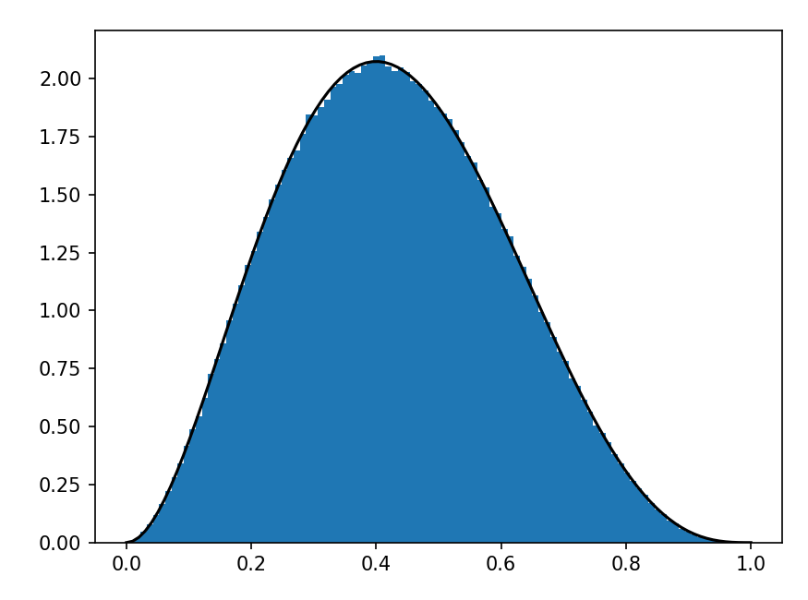
Example Beta Distribution
Randomly Choose
S = [[6.51982886+2.16887063j 2.14326226-2.25816968j 3.52035715+0.0622304j
6.6231837 +2.0843552j 2.88095633+2.72237248j]]
output: 360*x**2*(-x**3/6 + x**2/2 - x/2 + 1/6)*Heaviside(1 - x)

Slide 6
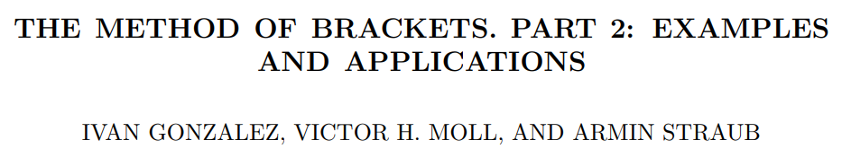
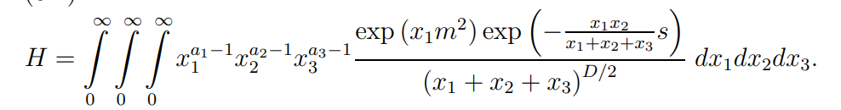
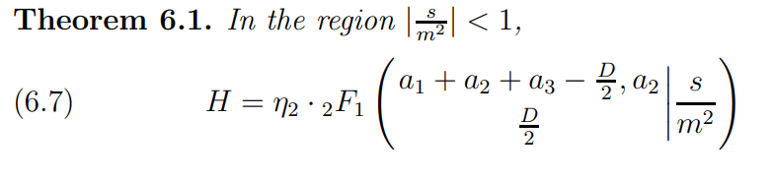
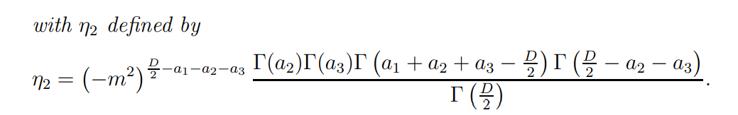
Modification to IMT – Particle Physics
Hypergeometric ‘moment’ junction type picture… Solutions as

